Slide 1

Spark Streaming
Let’s learn something!

Slide 2
Python and Spark
Spark Streaming is an extension of the core Spark API that enables scalable, high-throughput, fault-tolerant stream processing of live data streams.

Slide 3
Python and Spark
Data can be ingested from many sources like Kafka, Flume, Kinesis, or TCP sockets, and can be processed using complex algorithms expressed with high-level functions like map, reduce, join and window.

Slide 4
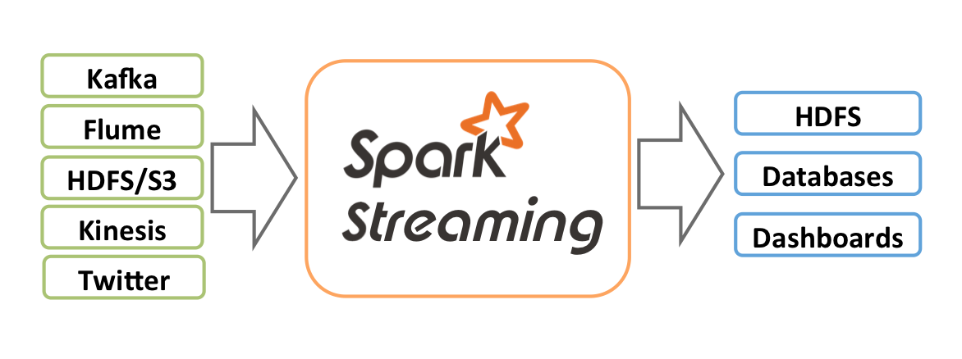
Python and Spark

Slide 5
Python and Spark
Internally, Spark Streaming receives live input data streams and divides the data into batches, which are then processed by the Spark engine to generate the final stream of results in batches.

Slide 6
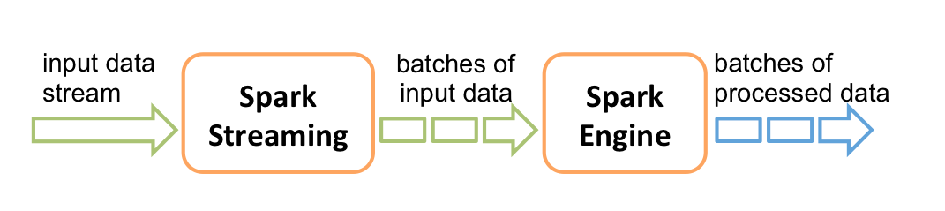
Python and Spark

Slide 7
Python and Spark
For this course we will first work through a simple streaming example.
You will need to simultaneously use jupyter notebook and a terminal for this.
This is easiest to follow through a local installation using Virtual Box.

Slide 8
Python and Spark
After working through that example we will finish off the course with a Twitter Analysis Project.
To follow along with this project you’ll need to install a few visualization libraries and set up a Twitter Developer Account.

Slide 9
Python and Spark
We’ll walk you through all these steps when the time comes during the lectures.

Slide 10
Python and Spark
The various possible data sources (Kafka, Flume,Kinesis, etc…) can not realistically be shown in a single computer setting.
If your place of work necessitates use of one of these sources, Spark provides full integration guides.

Slide 11
Python and Spark
Keep in mind not every source version is available with the Python API.
Let’s jump to the documentation to show you where you can find additional information on Spark Streaming!

Slide 12
Spark Streaming
Example Code Along

Slide 13
Python and Spark
Because we will be using Spark Streaming and not structured streaming (still experimental and in Alpha) we need to use some older “RDD” syntax.
This stems from using a SparkContext instead of a SparkSession.

Slide 14
Python and Spark
We will be building a very simple application that connects to a local stream of data (an open terminal) through a socket connection.
It will then count the words for each line that we type in.

Slide 15
Python and Spark
The steps for streaming will be:
Create a SparkContext
Create a StreamingContext
Create a Socket Text Stream
Read in the lines as a “DStream”

Slide 16
Python and Spark
The steps for working with the data:
Split the input line into a list of words
Map each word to a tuple: (word,1)
Then group (reduce) the tuples by the word (key) and sum up the second argument (the number one)

Slide 17
Python and Spark
That will then provide us with a word count in the form (‘hello’,3) for each line.
As a quick note, the RDD syntax relies heavily on lambda expressions, which are just quick anonymous functions.

Slide 18
Python and Spark
Fortunately, all the lambda expressions used here are quite simple and basic.
Let’s get started with this simple example!

Slide 19
Spark Streaming
Twitter Project Part One

Slide 20
Python and Spark
Now it is time for your final project!
We’ll create a simple application that plots out the popularity of tags associated with incoming tweets streamed live from Twitter.

Slide 21
Python and Spark
We first need to create a Twitter Developer Account to get our access codes.
Then you’ll need to install the tweepy library as well as matplotlib and seaborn.
Let’s get started by going to:
apps.twitter.com

Slide 22
Spark Streaming
Twitter Project Part Two

Slide 23
Python and Spark
Our next task is to write a script that will connect to Twitter for streaming.
This will be a .py file that we will call later on.
Let’s get started!

Slide 24
Spark Streaming
Twitter Project Part 3

Slide 25
Python and Spark
Now we will finish off our project by setting up a Jupyter Notebook with Spark that will connect to the socket connection created by TweetRead.py!
Remember to fill in your credentials for everything to work!

Slide 26
Python and Spark
For this lecture I highly recommend that you avoid typing out the instructions on your own and instead use the provided notebook:
Introduction to Spark Streaming.ipynb

Slide 27
Python and Spark
There are many places where a simple typo can mess everything up, and the nature of SQLContexts and the sockets will require you to restart your VirtualBox to get going again.

Slide 28
Python and Spark
Depending on how many times you run through this exercise, the port you assigned in TweetRead.py may already be in use, we’ll go over how to change that port.

Slide 29
Python and Spark
We also need to install one more library called pandas.
pip3 install pandas
Install this at the terminal and then restart you VirtualBox Ubuntu Machine before following along with this lecture.

Slide 30
Python and Spark
Here are the steps we’ll take:
Quickly review TweetRead.py
Open up the provided notebook file
Scroll down to the Twitter section
Run the .py files and cells in the correct order as we explain what is happening line by line.

Slide 31
Python and Spark
There are many steps that must be done in the exact order for this entire process to work!
If you do even a single step out of order, you’ll need to restart the VirtualBox and start over again.

Slide 32
Python and Spark
Using the provided TweetRead.py and Introduction to Spark Streaming.ipynb will save you a lot of time and frustration!
Let’s get started

